Slide 1
A study of the Fermi bubbles near the Galactic plane
Dmitry Malyshev,
Laura Herold
Fermi LAT diffuse meeting
August 15, 2017

Slide 2
General information about the project
People involved:
Dima Malyshev, Laura Herold
Category of project: II
Follow up work on the bubbles
Some results on the bubbles at low latitudes were already published in:
the Fermi LAT diffuse paper (arxiv:1602.07246)
the pass 8 GC analysis paper (arxiv:1704.03910)

Slide 3
Motivation
Origin of the Fermi bubbles
AGN-like emission from Sgr A*
Bubbles are expected to have an hour-glass shape centered at the GC
Starburst / star formation
Bubbles don’t need to be centered at the GC

Slide 4
Properties of the bubbles at high latitudes
Fermi LAT bubbles analysis paper (arxiv:1407.7905)
Bubbles at latitudes |b| > 10 deg
Homogeneous spectrum with a cutoff around 100 GeV
Homogeneous intensity + cocoon

Slide 5
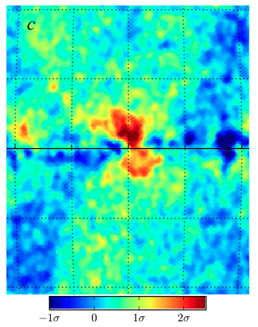
Previous analysis near the Galactic plane
Hints of a different behavior near the Galactic center
No cutoff at high energies
Higher intensity near the GC
Displaced from the GC to the right (negative longitudes)
Fermi LAT diffuse model
Acero et al (2016) arxiv:1602.07246
Pass 8 GC analysis Ackermann et al (2017)
arxiv:1704.03910

Slide 6
This analysis
Data selection:
Pass 8 Source class (relatively small area)
8 years (August 4, 2008, - August 3, 2016)
Energies between 300 MeV – 1 TeV in 24 logarithmic energy bins
HEALPix pixelation order 7 (resolution 0.5°)
Analysis strategy:
Very simple model using low-energy Fermi data → not many assumptions necessary
Comparison with GALPROP model

Slide 7
The low-energy model
Components:
Low-energy Fermi data (600 MeV – 1.6 GeV): N_{low} → spatial template of the foreground (IC + π⁰) that has a softer spectrum than the bubbles
Isotropic component: c
Normalization of N_{low} and c are fitted to higher-energy data in 4° latitude stripes in each energy bin individually (c absorbs IC and extragalactic diffuse)
Region of bubbles is excluded (-20° < l < 20°)
200 brightest point sources are masked

Slide 8
Low-energy model residuals

Slide 9
The boxes model
Components:
As before: N_{low}, c
Rectangles covering the Fermi bubbles (divided in east and west): b
Normalization of N_{low} and c and b are fitted to higher-energy data in 4° latitude stripes
Point sources are masked

Slide 10
GALPROP model + PS refitting (Dima)
Same analysis as in the Pass 8 GC excess study (Sample model)
Templates:
Gas correlated (π⁰ and brems) in 5 rings
IC in 3 components corresponding to IR, starlight, CMB
Geometric Loop I, Sun, Moon, Isotropic
Bubbles at |b| > 10 deg
GC excess (gNFW template)
3FGL point source + refit 40 brightest within R = 10º
Mask 200 brightest PS outside R = 10º
Fit independently in energy bins up to 600 GeV

Slide 11
GALPROP residual + bubbles
Residual + bubbles + GC excess:
NB: there is no PS mask within R = 10º from the GC

Slide 12
Latitude profiles
Longitude profiles east and west of GC (-10° < l < 10°)
Models agree well (on southern hemisphere)
Northern hemisphere: large amount of gas-correlated emission
Left-right asymmetry in the data
Left-right asymmetry in the models
Boxes model as baseline model?

Slide 13
Spectra in the Galactic plane
Spectra east and west of GC (-10° < l < 10°)
Difference of data: west – east > 0
Left-right asymmetry in models: harder spectrum west of GC

Slide 14
Timeline
End of September: Finish analysis → physics interpretation:
fit IC and π⁰ spectra,
particle lifetimes,
total energy output in terms of SNe
October: Present more results
End of October: Finish draft
13

Slide 15
Timeline
End of September: Finish analysis → physics interpretation:
fit IC and π⁰ spectra,
particle lifetimes,
total energy output in terms of SNe
October: Present more results
End of October: Finish draft
Thank you for listening!
Questions or comments?
14

Slide 16
Spectra slightly above the Galactic plane

Slide 17
Spectra slightly below the Galactic plane

